Slide 1
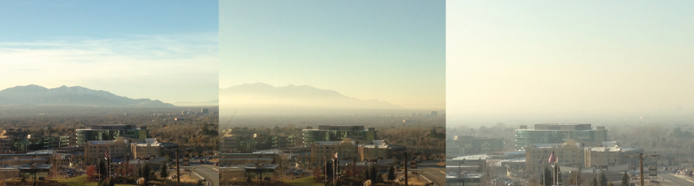
DS MINI-PROJECT
INDIAN AIR QUALITY DATA ANALYSIS
Guide : Prof. Shilpa Sonawani
GROUP NO. 9 :
PA 17 - Ketaki Patil
PA 31 - Anjali Nair
PB 43 - Shreyas Mavale
PB 45 - Rishikesh Mate

Slide 2
AGENDA
Problem Statement
Objectives
Dataset Description
Data Preprocessing
Data Analysis and visualization
System architecture
ML Algorithms
Output analysis
Visualization screenshots
Conclusion

Slide 3
Problem Statement
India has made it to the headlines when it comes to air pollution. The growing air pollution in the country has been one of the major concerns for both the government and the citizens.
Most of the population is not even aware of the colossal harm caused by the air they breathe everyday.
Air pollution in India is a serious issue, ranking higher than smoking, high blood pressure, child and maternal malnutrition, and risk factors for diabetes.
We hence propose a solution to help analyze the trend of AQI across India and also predicting AQI for future years.

Slide 4
Objectives
To calculate a locations Air Quality Index and determine the severity of air pollution in that region.
To backtrack the major pollution causing pollutant.
To identify locations affected seriously by the pollutant across India.
To design a model our model capable of predicting the air quality of India in any given area for future dates.
To create visualizations for analysis of air quality in different types of regions of a location.

Slide 5
Dataset
This data is combined(across the years and states) version of the Historical Daily Ambient Air Quality Data released by the Ministry of Environment and Forests and Central Pollution Control Board of India under the National Data Sharing and Accessibility Policy (NDSAP).
ROWS : 435743 COLUMNS :13
The dataset contains the following features :
stn_code : Station code. A code given to each station that made the measurements.
sampling_date : The date when the data was recorded.
state : It represents the states whose air quality data is measured.
location : It represents the city whose air quality data is measured.
agency : Name of the agency that measured the data.
type : The type of area where the measurement was made.
so2 : The amount of Sulphur Dioxide measured.
no2 : The amount of Nitrogen Dioxide measured.
rspm : Respirable Suspended Particulate Matter measured.
spm : Suspended Particulate Matter measured.
location_monitoring_station : It indicates the location of the monitoring area.
pm2_5 : It represents the value of particulate matter measured.
date : It represents the date of recording (It is cleaner version of 'sampling_date' feature)

Slide 6
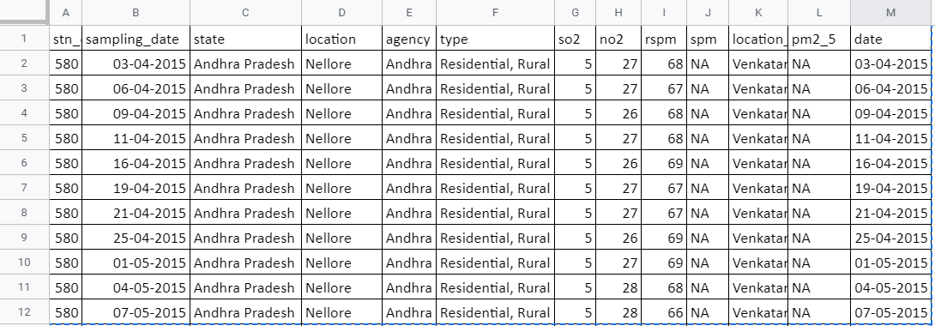
Dataset
This data is combined(across the years and states) version of the Historical Daily Ambient Air Quality Data released by the Ministry of Environment and Forests and Central Pollution Control Board of India under the National Data Sharing and Accessibility Policy (NDSAP).
ROWS : 435743 COLUMNS :13

Slide 7
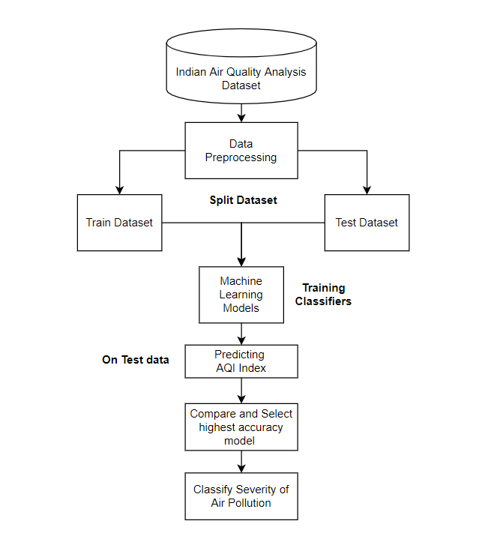
System
Architecture

Slide 8
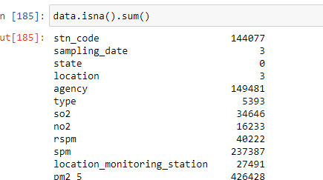
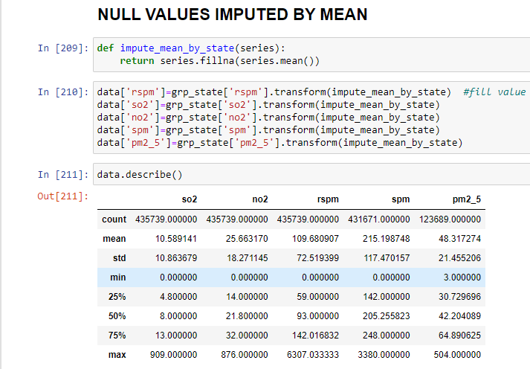
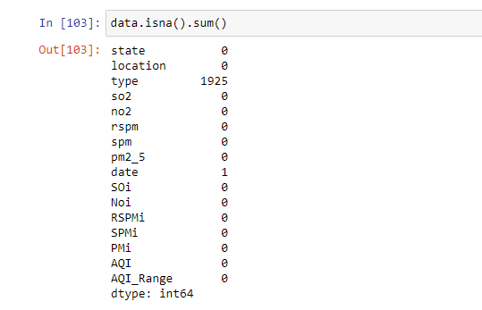
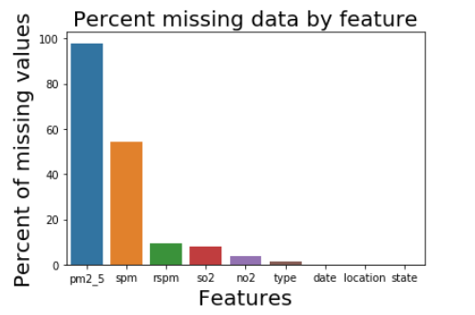
DATA PREPROCESSING

Slide 9
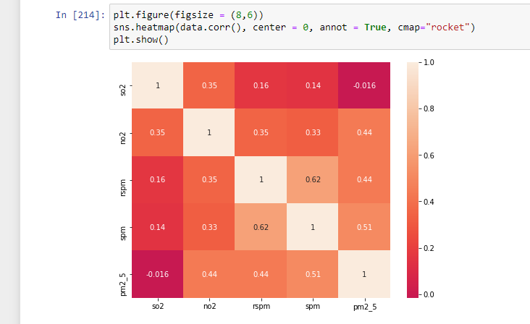
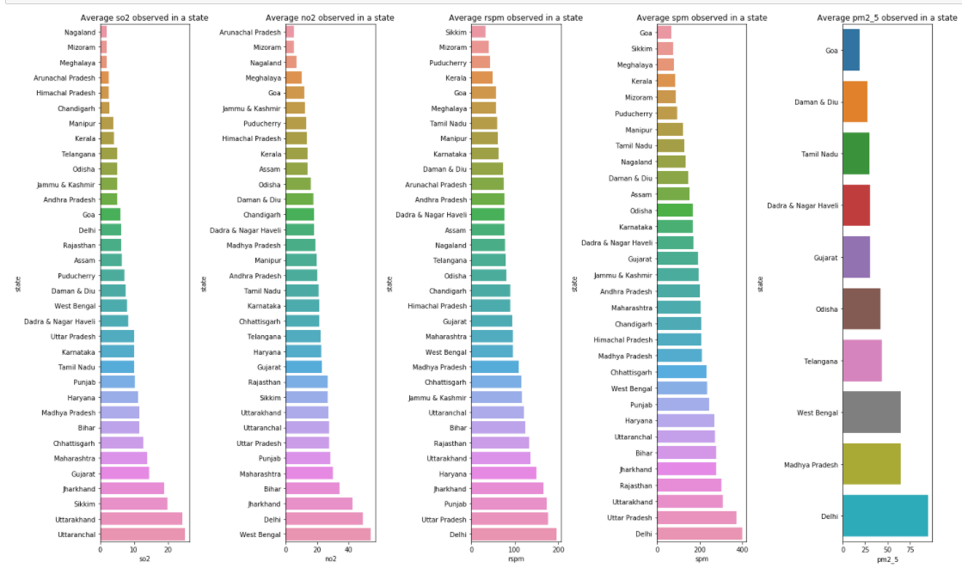
DATA ANALYSIS AND VISUALIZATION

Slide 10
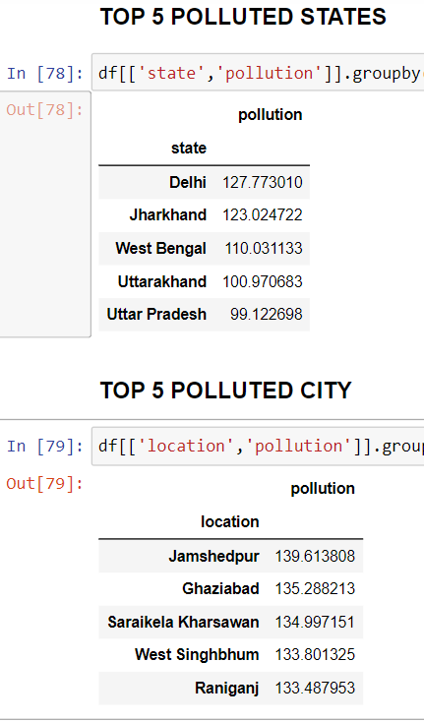
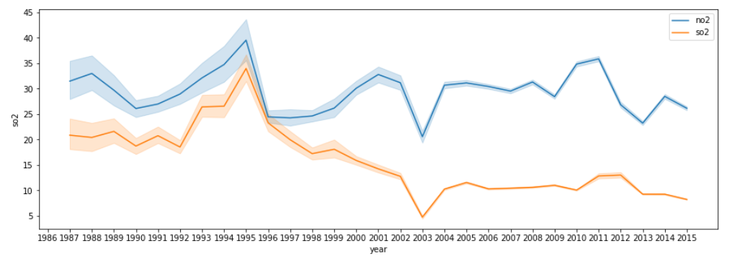
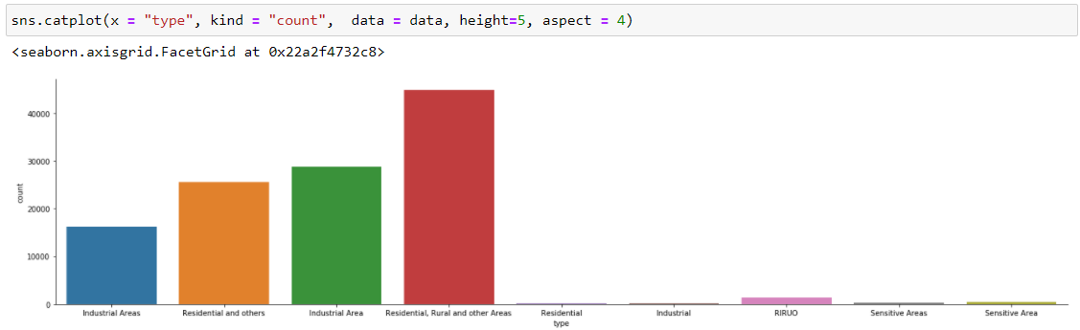

Slide 11
ML ALGORITHMS
Linear Regression :-
LR First: Accuracy Score :- 0.979
LR Second Accuracy Score :- 0.943
Logistic Regression:-
Logmodel First Accuracy Score :- 0.701
Logmodel Second Accuracy Score :- 0.683
Random Forest Classifier :-
Random model First Score :- 0.9997
Decision Tree Classifier :-
Decision Tree Classifier Score :- 0.9997

Slide 12
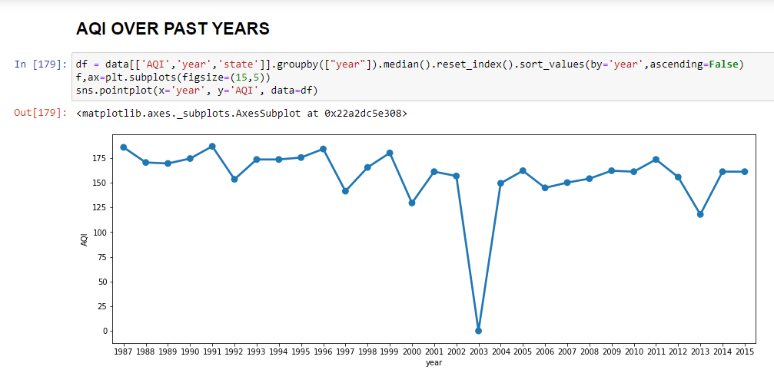
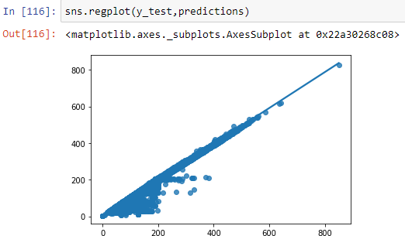
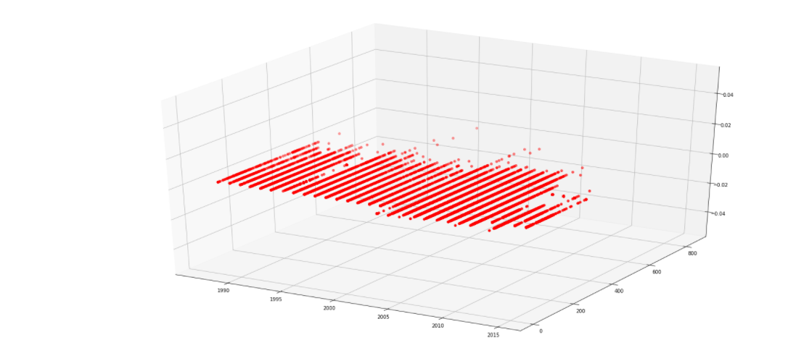
OUTPUT ANALYSIS
Model | Accuracy
Linear Regression | 97.91
Logistic Regression | 70.13
Random Forest | 99.97
AQI vs Year vs Values

Slide 13
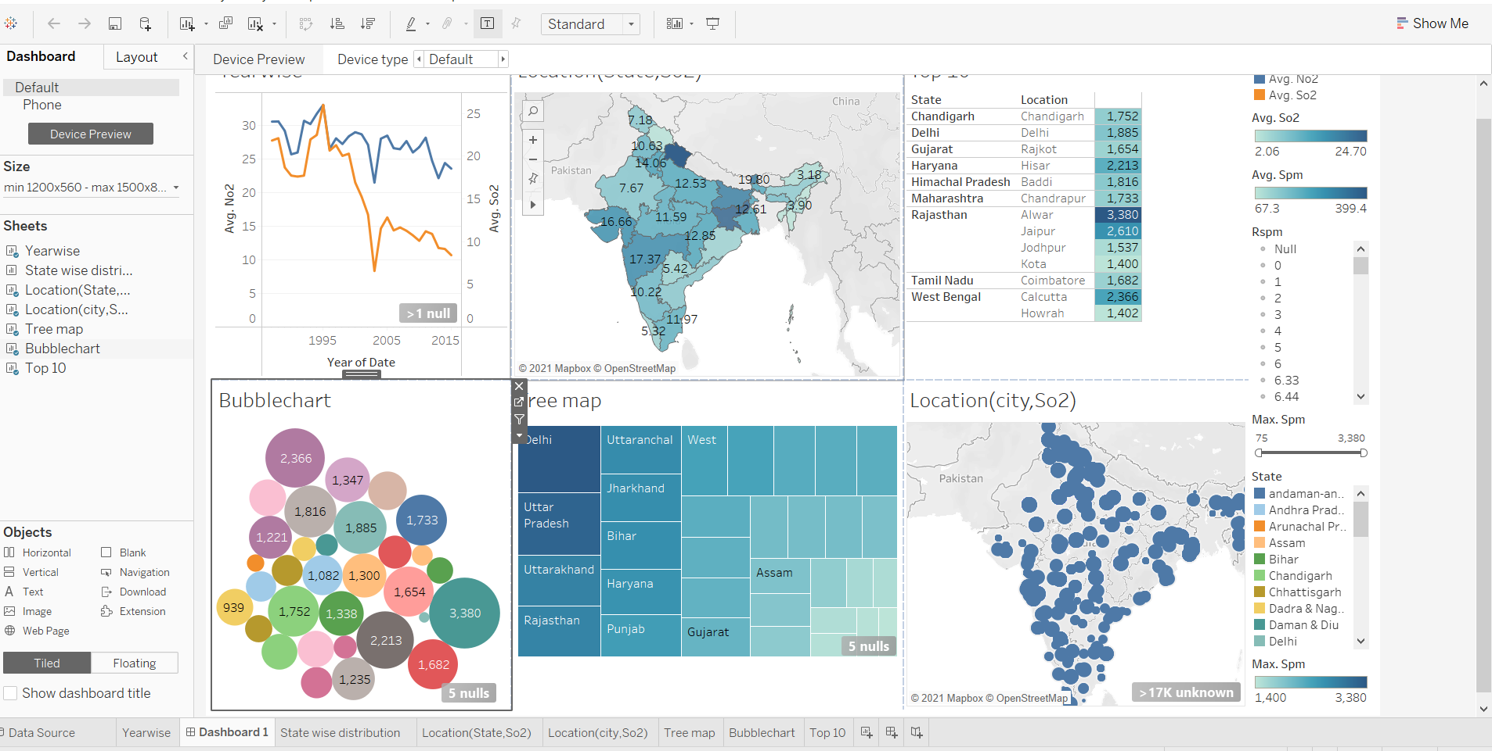
VISUALIZATION SCREENSHOTS

Slide 14
Conclusion
& Future Work
Since our model is capable of predicting the current data with 97.91% accuracy it will successfully predict the upcoming air quality index of any particular data within a given region.
With this model we can forecast the AQI and alert the respected region of the country also it a progressive learning model it is capable of tracing back to the particular location needed attention provided the time series data of every possible region needed attention.
The air quality information utilized in this report originates from the Indian air quality checking and investigation stage, and incorporates the normal every day fine particulate issue (PM2.5), inhalable particulate issue (PM10), ozone (O3), CO, SO2, NO2 fixation and air quality record(AQI).
In order to predict air quality, pm2_5 is also an important attribute. The values of this must be recorded in future as this particulates are responsible for various health effects including cardiovascular effects such as cardiac arrhythmias and heart attacks, and respiratory effects such as asthma attacks and bronchitis.
The dataset lacks information on the cities. If we predict for the entire state, it won’t be helpful. So, we can include extended parameters and use the model for further AQI forecasting and classification.

Slide 15
THANK YOU
GROUP NO. 9 :
PA 17 - Ketaki Patil
PA 31 - Anjali Nair
PB 43 - Shreyas Mavale
PB 45 - Rishikesh Mate

Slide 16
http://www.jcreview.com/fulltext/197-1592899246.pdf
https://www.sci-hub.se/10.1109/ACCESS.2019.2925082
 | https://ieeexplore.ieee.org/abstract/document/9063845
https://www.sci-hub.se/10.1109/ICATIECE45860.2019.9063845 | Urban Air Quality Analysis and Prediction Using Machine Learning
 | https://ieeexplore.ieee.org/abstract/document/9074431
https://www.sci-hub.se/10.1109/ICACCS48705.2020.9074431 | Air Quality Prediction Of Data Log By Machine Learning
 | https://ieeexplore.ieee.org/abstract/document/8929517
https://www.sci-hub.se/10.1109/TENCON.2019.8929517 | Urban Air Quality Prediction Using Regression Analysis

